Slide 1
AN OVERVIEW OF HEALTH CHECK PATTERNS

Slide 2



An Overview of Health Check Patterns
Oresztesz Margaritisz – Chief Software Engineer <EPAM>
May 18-19-20, 2021

Slide 3



FAIL!

Slide 4


Slide 5

96%
99%
99%
CPU
RAM
99%
Network
99%
Disk

Slide 6
CPU
RAM
CPU
RAM
CPU
RAM
Network
Network
Network
Disk
Disk
Disk
CLIENT
SERVER
DB

Slide 7
88.5%
99%
99%
99%
99%
99%
99%
99%
99%
99%
99%
99%
99%
CLIENT
SERVER
DB

Slide 8
CPU
RAM
CPU
RAM
Network
Network
Disk
Disk
CLIENT
SERVER

Slide 9

bugs
config issue
synchronization failed
memory leak
thread leak
pool misconfigurations
deadlocks

Slide 10
CPU
RAM
Network
Disk
CPU
RAM
Network
CPU
RAM
Disk
Network
Disk
CPU
RAM
Network
CPU
RAM
Disk
Network
Disk

Slide 11

CPU
RAM
Network
Disk
CPU
RAM
Network
CPU
RAM
Disk
Network
Disk
CPU
RAM
Network
CPU
RAM
Disk
Network
Disk
Notes:
TODO – true story: AWS

Slide 12
HEALTH CHECK?

Slide 13
?
TELL? LIE?
CPU
RAM
!
Network
ACTION
Disk

Slide 14
!
ACTION
RESTART
TRAFFIC
SHAPING
DEPLOYMENTS
ALERTING
SCALING

Slide 15
TELL?
LIE?
RETRIES
CIRCUIT
BREAKER
?
?
DEFAULTS
?
TIMEOUTS
FALLBACKS
Notes:
Retries?
- Not necessary, healtcheck can retry itself if you give it a lease period.
Fallbacks & Defaults?
- Deep healthcheck might ruin the effect of fallbacks
# Required patterns
Timeouts
- Either in application or at LB level
- Don’t set your dependency timeouts longer than healthcheck timeouts

Slide 16
TELL?
LIE?
N/A
SHALLOW
DEEP
PASSIVE

Slide 17
PATTERNS!

Slide 18







Envoy
CPU
RAM
Network
Disk
Notes:
DEMO CHECKLIST
- Minikube start
Minikube dashboard
Delete all quarkus docker images
Make build compose
Make build k8s-deploy
- Make dev
e2e warmup
DEMO SCENARIO
Healthcheck in dev
Envoy healthcheck with outlier detection & health
Kube restarts?
Kube deploy & rollback

Slide 19

CPU
RAM
Network
Disk
Kubernetes
Notes:
DEMO CHECKLIST
- Minikube start
Minikube dashboard
Delete all quarkus docker images
Make build compose
Make build k8s-deploy
- Make dev
e2e warmup
DEMO SCENARIO
Healthcheck in dev
Envoy healthcheck with outlier detection & health
Kube restarts?
Kube deploy & rollback

Slide 20
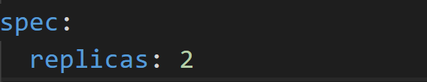
N/A
RESTARTS
Notes:
*Restart*
+ Based on existing requests / limits
- If your container is not exiting properly you can face issues

Slide 21
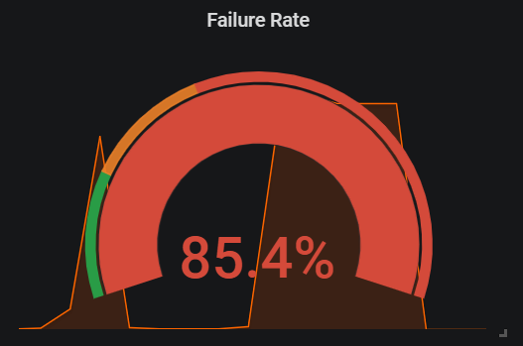
N/A
ALERTING
Notes:
*Alerting*
+ Based on the ratio of failed HTTP requests indirectly (passive)
- Not working for TCP

Slide 22
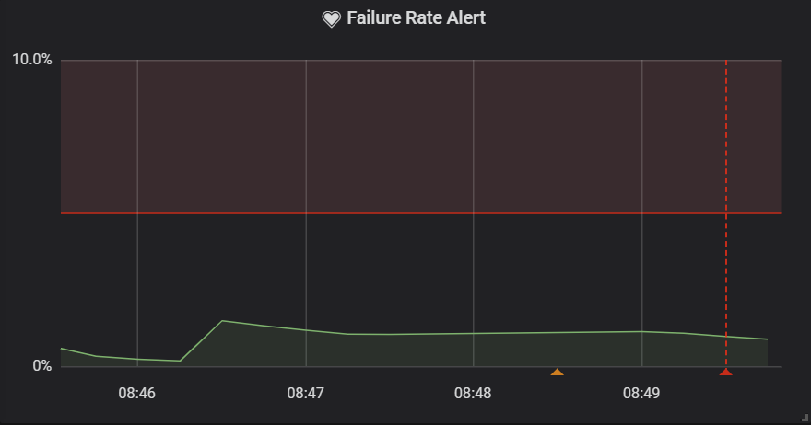
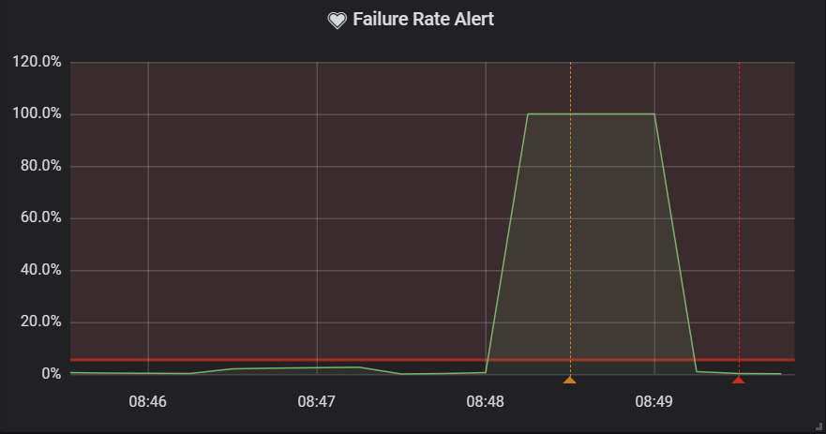
N/A
ALERTING
Interval = 5m
Interval = 1m
Notes:
- *DELAYING* if the rate drops because a dependent service timing out

Slide 23
N/A
TRAFFIC SHAPING
DEPLOYMENTS
Notes:
*Traffic shaping*
N/A

Slide 24
N/A
memory leak
thread leak
bugs
config issue
pool misconfigurations
deadlocks

Slide 25
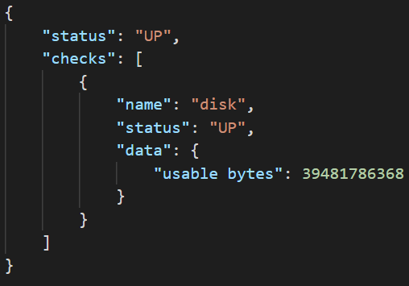
SHALLOW

Slide 26
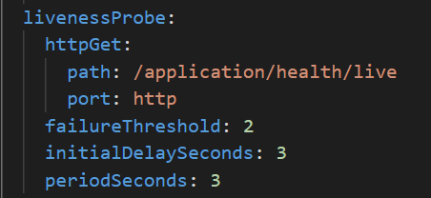
RESTARTS
SHALLOW
Notes:
## Shallow healthcheck
*Restarts*
+ Helps if application has: memory, thread leak
- Won't help if dependent service becomes unavailable
- Won't help in case of deadlocks, pool misconfigs, bugs

Slide 27
TRAFFIC SHAPING
SHALLOW
CPU
RAM
Network
Disk
Notes:
## Shallow healthcheck
*Traffic shaping*
+ Guarantees that only healthy services will recieve traffic
+ Reduces failure rate becasue of downtime
- Won't help if dependent services are not operational
*Alerting*
+ Based on reported health check status
- Not working if a dependent service is not operational
+ Based on the ratio of failed HTTP requests indirectly (passive)
- *DELAYING* if the rate drops because a dependent service timing out

Slide 28
CONNECTION POOL ISSUES
timeout
invalid connections
blocked threads
unbounded pool
overflooding
thread / memory leaks
SHALLOW
Notes:
## Shallow healthcheck *Traffic shaping*
+ Guarantees that only healthy services will recieve traffic
+ Reduces failure rate becasue of downtime
- Won't help if dependent services are not operational

Slide 29
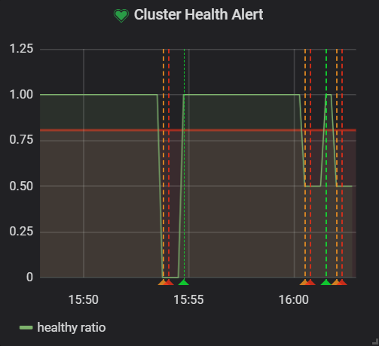
ALERTING
SHALLOW
Notes:
## Shallow healthcheck
*Alerting*
+ Based on reported health check status
- Not working if a dependent service is not operational

Slide 30
SHALLOW
DEPLOYMENTS

Slide 31
memory leak
thread leak
SHALLOW
bugs
config issue
pool misconfigurations
deadlocks

Slide 32
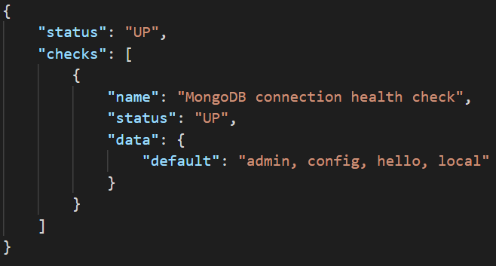
DEEP

Slide 33
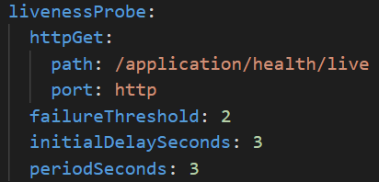
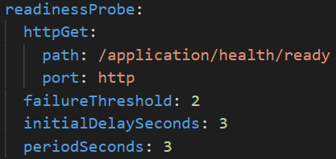
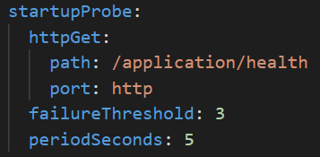
RESTARTS & DEPLOYMENTS
DEEP
Notes:
*Restart*
+ Helps if application has: memory, thread leak, pool misconfigurations
+ Might help if timeout pattern is not applied.
- Might help in case of deadlocks, if we probe the system with synthetic requests.
- You have to distinguish synthetic data from real usage statistics!
- To take maximum effect, we should monitor current service status and expose it

Slide 34
FAIL OPEN
CPU
RAM
CPU
RAM
Network
Network
DEEP
Disk
Disk
Notes:
*Traffic shaping*
+ Removes pressure from services until they become healthy again
+ Keeps pool alive if I don’t have proper pool settings, like validation
- _"If the DB server has become a single point of failure (SPOF) and has gone down, there may be an overreaction that can take all of the servers down, depending on how the back-end server check program is written."_
- Can ruin the effect of fallbacks and defaults
*Alerting*
+ Better understanding on higher level from application perspective
+ Overview on current state even if network partitioning occurs

Slide 35
TRAFFIC SHAPING
CPU
RAM
Network
Disk
?
fallbacks
defaults
DEEP
Notes:
*Traffic shaping*
+ Removes pressure from services until they become healthy again
+ Keeps pool alive if I don’t have proper pool settings, like validation
- _"If the DB server has become a single point of failure (SPOF) and has gone down, there may be an overreaction that can take all of the servers down, depending on how the back-end server check program is written."_
- Can ruin the effect of fallbacks and defaults
*Alerting*
+ Better understanding on higher level from application perspective
+ Overview on current state even if network partitioning occurs

Slide 36
PROBING
CPU
RAM
Network
Disk
bugs
deadlocks
fallbacks
defaults
DEEP
Notes:
*Traffic shaping*
+ Removes pressure from services until they become healthy again
+ Keeps pool alive if I don’t have proper pool settings, like validation
- _"If the DB server has become a single point of failure (SPOF) and has gone down, there may be an overreaction that can take all of the servers down, depending on how the back-end server check program is written."_
- Can ruin the effect of fallbacks and defaults
*Alerting*
+ Better understanding on higher level from application perspective
+ Overview on current state even if network partitioning occurs

Slide 37
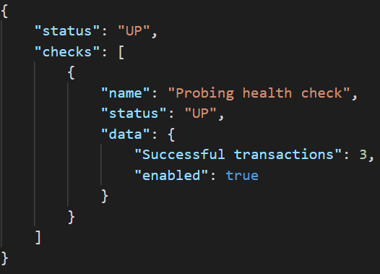
PROBING
DEEP
Notes:
*Traffic shaping*
+ Removes pressure from services until they become healthy again
+ Keeps pool alive if I don’t have proper pool settings, like validation
- _"If the DB server has become a single point of failure (SPOF) and has gone down, there may be an overreaction that can take all of the servers down, depending on how the back-end server check program is written."_
- Can ruin the effect of fallbacks and defaults
*Alerting*
+ Better understanding on higher level from application perspective
+ Overview on current state even if network partitioning occurs

Slide 38
memory leak
thread leak
pool misconfigurations
bugs
config issue
deadlocks
DEEP

Slide 39
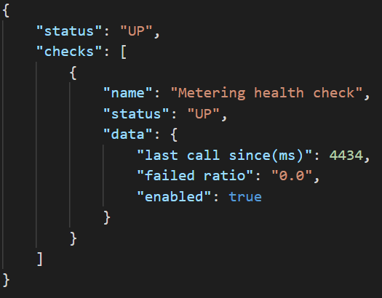
PASSIVE
Notes:
## Passive healthcheck
*Restart*
+ To take maximum effect, we should monitor current service status and expose it
- Hard to nail it

Slide 40
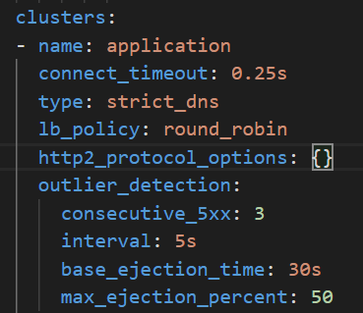
TRAFFIC SHAPING
PASSIVE
Notes:
*Traffic shaping*
+ Removes pressure from services until they become healthy again
+ Don't have to sync your configuration with fallbacks, defaults, circuit-breakers

Slide 41
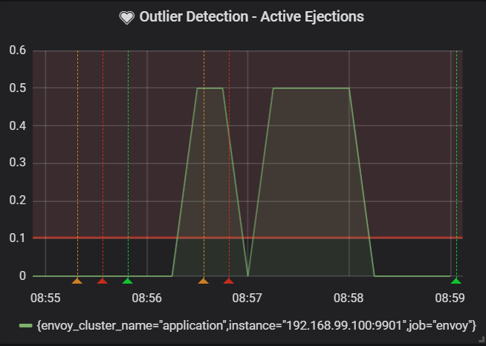
ALERTING
PASSIVE
Notes:
*Alerting*
+ Better understanding on higher level from application perspective
+ Overview on current state even if network partitioning occurs
- Need to be combined with “active health checking in order to catch issues ahead, when there’s no traffic on the cluster.

Slide 42
memory leak
thread leak
pool misconfigurations
bugs
config issue
deadlocks
PASSIVE

Slide 43
DEMO!

Slide 44





THANK YOU!
ORESZTÉSZ MARGARITISZ
@gitaroktato
gitaroktato
https://www.linkedin.com/in/oresztesz

Slide 45
LINKS & REFERENCES
An Overview of Health Check Patterns
Reference implementation
Release It!
Introduction to modern network load balancing and proxying
Deep Health Check Pattern
Implementing health checks in AWS
Kubernetes Liveness, Readiness and Startup Probes
Quarkus microprofile-health

Slide 46


Slide 47

AN OVERVIEW ON HEALTH CHECK PATTERNS

